Slide 1

3413ICT Network Security Dr V. Muthukkumarasamy B.Sc.Eng (Hons) (Peradeniya), PhD (Cantab)

Slide 2
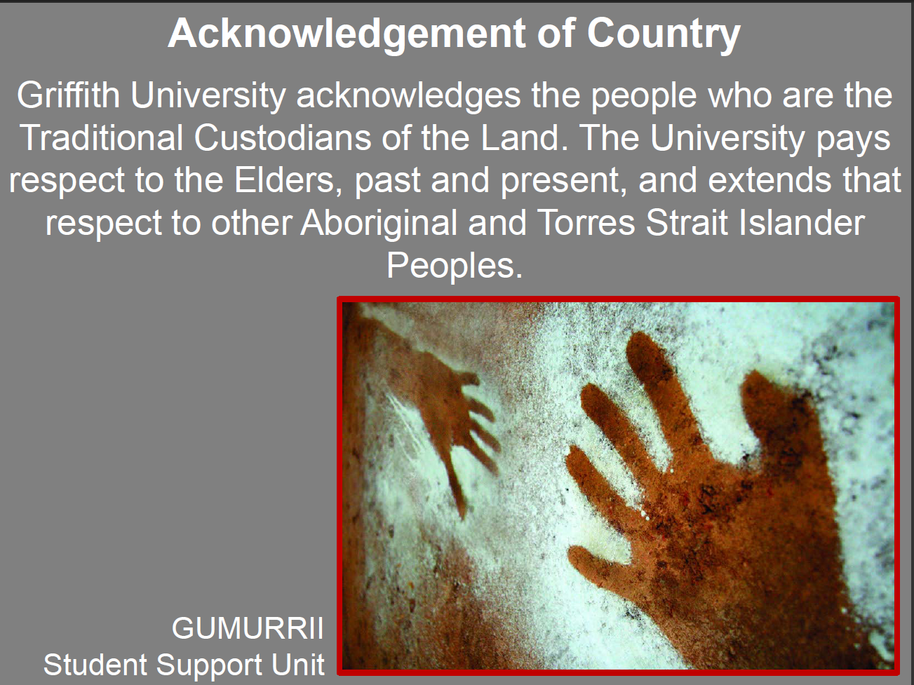

Slide 3
Objectives
At the end of this lecture you will have learnt:
Contact details for your course convenor
How to access the course website
What this course aims to achieve
The assessment requirements for this course
How student feedback helps us to improve the offering of the course
Details regarding the prescribed textbook
The contents of the course
The basics of information security/ network security and classical cryptography

Slide 4
Course Information
Course Convenor & Lecturer:
Dr V. Muthukkumarasamy
Room: G23_2.37
Phone: 555 28256
Email: v.muthu@griffith.edu.au
Workshop Tutor:
Name: TBA
Email: TBA
Course Website:
Access Lecture Notes / announcements
Learning@Griffith

Slide 5
Course details
Attendance
3 hours of lectures/ Week
3 hours of labs/ workshops each week (must attend)
Workshop/ Laboratory Allocations
Done when you enrolled
Must advise tutors if you any difficulties
Workshop/ Laboratory Activities
Each week you will undertake 3 hours of laboratory/ learning activities.
In general each laboratory session will include an assessment carrying 2 marks for each week

Slide 6
Content
Introduction to Information System Security
Symmetric Encryption and Confidentiality
Public-Key Cryptography and Authentication
Authentication Applications
Electronic Mail Security
IP Security
Web Security
Intruders
Malicious Software
Firewalls
Information Systems Security Management
Mid-Semester Exam

Slide 7
Content…
Network protocols and security
Advanced cryptography for network security
Wireless local area networks
Wireless network security
Database security
Network anomaly detection
Access control for network security
Trusted computing
Administering a secure network
Risk assessment and mitigation
Revision

Slide 8
Assessment
Assessment Item | Weight | Due
Learning Activities/ Lab Exercises (workshop time) | 20% | Week 2 - 12
Mini Test 1 (Lecture time) | 5% | 26 March
Assignment 1 | 10% | 11 April
Mid Semester Exam (Lecture time) | 10% | 30 April
Assignment 2 | 10% | 23 May
Mini Test 2 (Lecture time) | 5% | 28 May
Final Exam | 40% | 14 – 28 June
All Exams are CLOSED Book

Slide 9
Assessment…
Learning activities/ Lab exercises (20% overall)
10 individual learning activities/ laboratory based activities
Worth 2% each week
Held weeks 2, 3, 4, 5, 6, 7, 9, 10, 11 and 12
Completed in your laboratory class
Individual Assignments (2x 10 = 20%)
Assignment 1: Due 4pm Friday week 6
Assignment 2: Due 4pm Friday week 11
Mid-Semester Exam (10%)
Lecture time, Week 8
Mini tests (worth 10% total)
Two mini tests worth 5% each held at the beginning of the lecture in Week 4 and Week 12
Final Exam (worth 40%)

Slide 10
Assessment…
Requirements
The lab-work/ learning activities are considered a single piece of assessment. You must submit at least 50% of all learning activities for a mark to be entered for this component.
Students must obtain at least 40% in the final examination and 50% overall to obtain a pass.
Penalties apply to late submissions as per course outline.

Slide 11
Student feedback
The teaching staff are committed to continuous review and improvement of this course.
At the end of the semester you will be given the opportunity to provide anonymous on-line feedback.
Your feedback allows us to identify issues with the course and its delivery.
This will enable us to improve the course before its next offering.

Slide 12
Student feedback
In feedback from the previous offering some students indicated a lack of hands-on laboratory work.
We have attempted to address these concerns by:
Introducing appropriate laboratory components into the course.

Slide 13
Texts and References
The prescribed text is:
Cryptography and Network Security: Principles and Practice, 6e, William Stallings, Pearson, 2013
Computer Security: Principle and Practice, 2e, William Stallings, Lawrie Brown, Pearson, 2012
Recommended references include:
Security+ Guide to Network Security Fundamentals, 3e, Mark Ciampa, Course Technology Cengage Learning, 2009
Security in Computing, 3e, Charles & Shari, Prentice Hall, 2003

Slide 14
Plagiarism
Do not do it!

Slide 15
What is plagiarism?
It is cheating, and stealing
It is an attempt to gain credit for something that is not your property, not your idea or not your work.
It is taking the intellectual contents produced by others and pretending that is your own production.
If you didn’t produce it, it is not yours

Slide 16
Why students plagiarise?
Research indicates that plagiarism occurs when
Students plan poorly their time
Students do not use the resources available when dealing with an assignment
Students feel they there is a culture where they can get away with it
Students feel they are incapable of completing the task

Slide 17
3413ICT Network Security
Lecture 1. Introduction

Slide 18

"It is not the mouse that is the thief, It is the hole that let the mouse in"
Babylonian Talmud, Tractate Baba Metzia

Slide 19
Outline
Computer security / Information system security / Network security
Classical cryptography
Substitution ciphers
Caesar cipher
Vigenère cipher
Transposition ciphers

Slide 20
Information Security
Information Security requirements have changed in recent times
Traditionally provided by physical and administrative mechanisms
Widespread use of computers requires automated tools to protect stored information
Use of networks and communications links requires measures to protect data during transmission

Slide 21
Definitions
Computer Security - generic name for the collection of tools, designed to protect data and to thwart hackers
Network Security - measures to protect data in networked systems
Internet Security - measures to protect data during their transmission over the Internet

Slide 22
Network Security Tools
This course will focus on Network Security
Consists of measures to prevent, detect, and correct security violations that involve storage & transmission of information
Basic tools to implement those measures
Encryption
Message digests
Protocols

Slide 23
Attacks, Mechanisms, Services
Given an information system, we usually consider three aspects of information security:
Security attack
Security mechanism
Security service

Slide 24
Security Service
A service that enhances the security of the system for data storage, data processing, or data transmission
Intended to counter security attacks
Make use of one or more security techniques (and/or security policies), to provide the service

Slide 25
Security Services …
Authentication - assurance that the communicating entity is the one claimed
Access Control - prevention of the unauthorized use of a resource
Data Confidentiality - protection of data from unauthorized disclosure
Data Integrity - assurance that data received is as sent by an authorized entity
Non-Repudiation - protection against denial by one of the parties in a communication
Notes:
See Table 1.4 for details of the 5 Security Service categories and the 14 specific services.

Slide 26
Security Mechanism
A mechanism that is designed to detect, prevent, or recover from a security attack
No single mechanism that will support all required functions
One particular element underlies many of the security mechanisms in use: cryptographic techniques.

Slide 27
Security Attack
Any action that compromises the security of information owned by an organization
Information security is about how to prevent attacks, or failing that, to detect attacks on information-based systems
Have a wide range of attacks
Notes:
cf. Table 1.2 for examples of security attacks, and Table 1.3 for definitions of threat and attack

Slide 28
Security Attacks Classification
Passive attacks - eavesdropping on, or monitoring of, transmissions to:
Monitor traffic flows, or
Obtain message contents
Active attacks – includes:
Masquerading of one entity as some other
Modifying messages in transit
Denial of service (disabling the system)

Slide 29
Basic Crypto Terminology
Plaintext - the original message
Ciphertext - the coded message
Cipher - algorithm for transforming plaintext to ciphertext and vice versa
Key - info used in cipher known only to sender/receiver
Encipher (encrypt) - converting plaintext to ciphertext
Decipher (decrypt) - recovering plaintext from ciphertext
Cryptography - study of encryption principles/methods
Cryptanalysis (codebreaking) - the study of methods of deciphering ciphertext without knowing key
Cryptology - the field of both cryptography and cryptanalysis
Notes:
Briefly review some terminology used throughout the course.

Slide 30
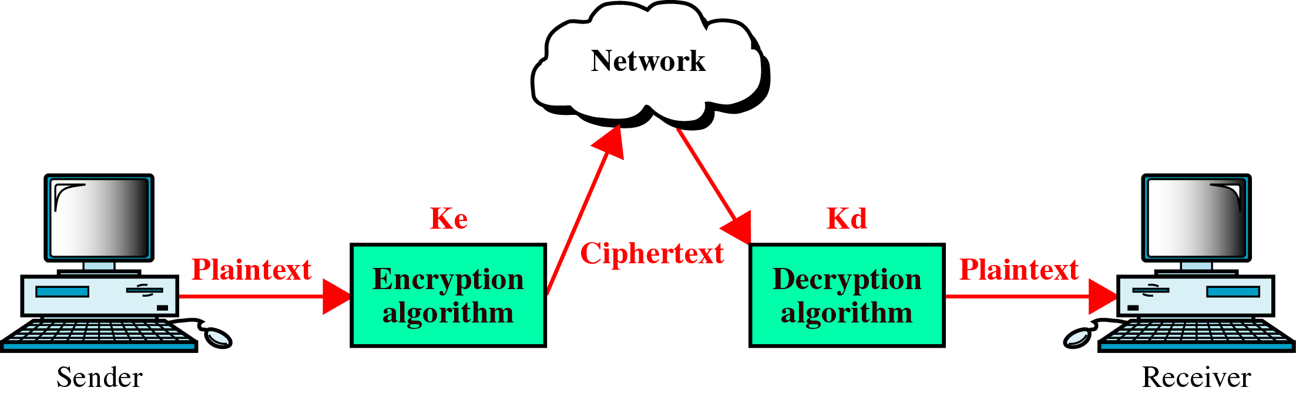
General Cipher Model

Slide 31
Cryptography
Can characterize by:
Type of encryption operations used
Substitution / Transposition / Product
Number of keys used
Single-key (or Private, Symmetric) / Two-key (or Public, Asymmetric)
Way in which plaintext is processed
Block / Stream

Slide 32
Symmetric Cipher
Also known as:
Conventional cipher
Private key cipher
Secret key cipher
Single key cipher
Sender and recipient share a common key
Symmetric ciphers were commonly used prior to invention of Public Key Ciphers in 1970’s
Notes:
All traditional schemes are symmetric / single key / private-key encryption algorithms, with a single key, used for both encryption and decryption, since both sender and receiver are equivalent, either can encrypt or decrypt messages using that common key.

Slide 33
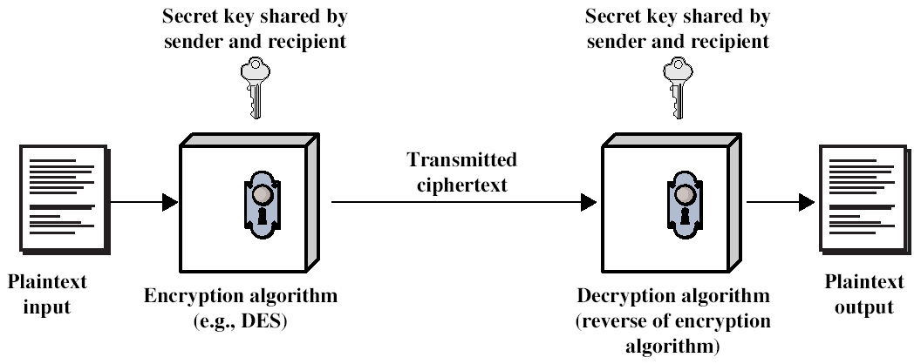
Symmetric Cipher Model
Secure channel
Simplified Model of Conventional Encryption
(based on Stallings, Figure 2.1)
Notes:
Detail 5 ingredients of the symmetric cipher model:
plaintext
encryption algorithm – performs substitutions/transformations on plaintext
secret key – control exact substitutions/transformations used in encryption algorithm
ciphertext
decryption algorithm – inverse of encryption algorithm

Slide 34
Requirements(exam question)
Two requirements for secure use of symmetric encryption:
Strong encryption algorithm
Secret key known only to sender / receiver
Y = E_{K}(X)
X = D_{K}(Y)
Can assume encryption algorithm is known
A secure channel to distribute key
Notes:
Generally assume that the algorithm is known.
This allows easy distribution of s/w and h/w implementations.
Hence assume just keeping key secret is sufficient to secure encrypted messages.
Have plaintext X, ciphertext Y, key K, encryption alg Ek, decryption alg Dk.

Slide 35
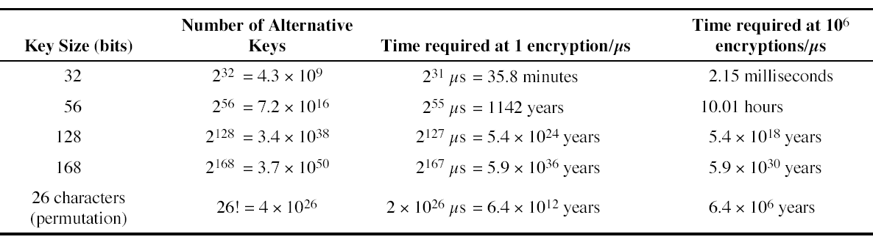
Brute Force Search
Always possible to simply try every key
Most basic attack, proportional to key size
Assume recognise plaintext
(Stallings Table 2.2)

Slide 36
Cryptanalytic Attacks
Ciphertext only
Only know algorithm & ciphertext - statistical, can identify plaintext
Known Plaintext
Know/suspect plaintext & ciphertext to attack cipher
Chosen plaintext
Select plaintext and obtain ciphertext to attack cipher
Chosen ciphertext
Select ciphertext and obtain plaintext to attack cipher
Chosen text
Select either plaintext or ciphertext to en/decrypt to attack cipher.

Slide 37
Computational Security(Exam Question)
Unconditional Security
No matter how much computer power and how much time are given, the cipher can not be broken
Computational Security
Given limited computing resources (e.g., time needed for calculations is greater than age of human), the cipher cannot be broken.
Notes:
Unconditional security would be nice, but the only known such cipher is the one-time pad (later). For all reasonable encryption algorithms, have to assume computational security where it either takes too long, or is too expensive, to bother breaking the cipher.

Slide 38
Classical Substitution Ciphers
Substitution
Where letters of plaintext are replaced by other letters, or numbers, or symbols
Transposition
The plaintext is encrypted by changing the positions of the letters and/or symbols, by some sort of permutation
Notes:
In this section and the next, we examine a sampling of what might be called classical encryption
techniques. A study of these techniques enables us to illustrate the basic approaches to
symmetric encryption used today and the types of cryptanalytic attacks that must be anticipated.
The two basic building blocks of all encryption techniques: substitution and transposition.
We examine these in the next two sections. Finally, we discuss a system that combine both
substitution and transposition.

Slide 39
Caesar Cipher
An example of substitution cipher
Send the money to Alice
Vhqg wkh prqhb wr Dolfh
plain
ABCDEFGHIJKLMNOPQRSTUVWXYZ |||||||||||||||||||||||||| DEFGHIJKLMNOPQRSTUVWXYZABC
+3
= cipher

Slide 40
Caesar Cipher
Can define transformation as:
a b c d e f g h i j k l m n o p q r s t u v w x y z
D E F G H I J K L M N O P Q R S T U V W X Y Z A B C
Mathematically give each letter a number
a b c d e f g h i j k l m n o p q r s t u v w x y z
0 1 2 3 4 5 6 7 8 9 ………………………………………………………………………………25
Then Caesar cipher is represented as:
C = E(p) = (p + k) mod 26
p = D(C) = (C – k) mod 26
Notes:
This mathematical description uses modulo arithmetic (ie clock arithmetic). Here, when you reach Z you go back to A and start again. Mod 26 implies that when you reach 26, you use 0 instead (ie the letter after Z, or 25 + 1 goes to A or 0).
Example: howdy (7,14,22,3,24) encrypted using key f (5) is MTBID

Slide 41
Cryptanalysis of Caesar Cipher
Only have 26 possible ciphers
A maps to A, B, ..., Z
Could simply try each in turn, by a brute force search
Given ciphertext, just try all shifts of letters
Do need to recognize when have plaintext
An example – break the following ciphertext:
XJSI YMJ RTSJD YT FQNHJ
Notes:
With a caesar cipher, there are only 26 possible keys, of which only 25 are of any use, since mapping A to A etc doesn't really obscure the message! cf. basic rule of cryptanalysis "check to ensure the cipher operator hasn't goofed and sent a plaintext message by mistake"!
Can try each of the keys (shifts) in turn, until can recognise the original message. See Stallings Fig 2.3 for example of search.
Note: as mentioned before, do need to be able to recognise when have an original message (ie is it English or whatever). Usually easy for humans, hard for computers. Though if using say compressed data could be much harder.
Example "GCUA VQ DTGCM" when broken gives "easy to break", with a shift of 2 (key C).

Slide 42
Mono-alphabetic Cipher
Rather than just shifting the alphabet, we could shuffle (jumble) the letters arbitrarily
Each plaintext letter maps to a randomly selected letter
Hence, key is 26 letters long:
Plain: abcdefghijklmnopqrstuvwxyz
Cipher: DKVQFIBJWPESCXHTMYAUOLRGZN
Plaintext: SEND THE MONEY TO AliCE
Ciphertext: AFXQ UJF CHXFZ UH DSWVF

Slide 43
Mono-alphabetic Cipher Security
Now have a total of 26! = keys
With so many keys, you might think this cipher is secure
WRONG !!!
It can be broken by using English letter frequencies.

Slide 44
English Letter Frequencies
Letters are not equally commonly used
In English E is by far the most common letter
Then T,R,N,I,O,A,S
Other letters are fairly rare: e.g. Z,J,K,Q,X
Notes:
As the example shows, we don't actually need all the letters in order to understand written English text. Here vowels were removed, but they're not the only redundancy. cf written Hebrew has no vowels for same reason. Are usually familiar with "party conversations", can hear one person speaking out of hubbub of many, again because of redundancy in aural language also. This redundancy is also the reason we can compress text files, the computer can derive a more compact encoding without losing any information. Basic idea is to count the relative frequencies of letters, and note the resulting pattern.

Slide 45
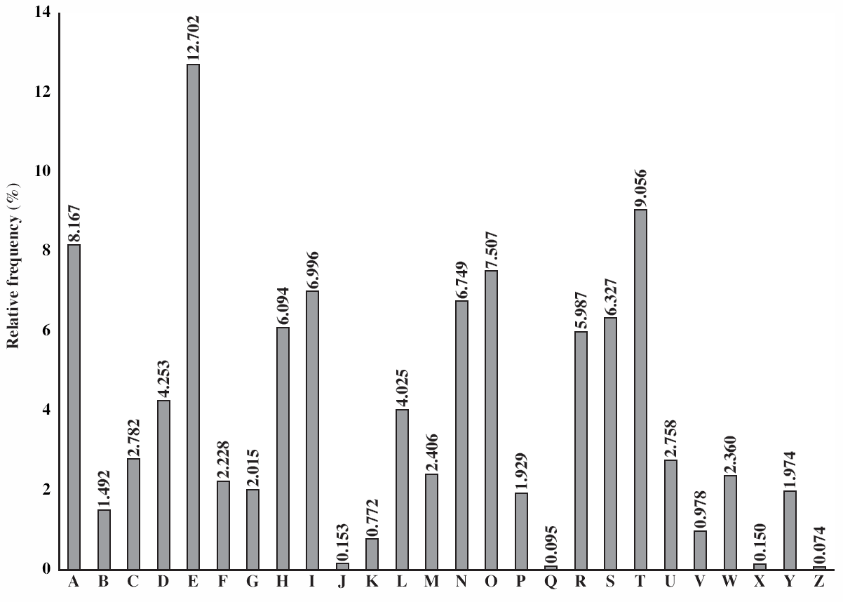
English Letter Frequencies
(Stallings – fig 2.5)
Notes:
This graph is based on counts done at ADFA in the late 1980's, and used to develop the tables published in Seberry & Pieprzyk [SEBE89].
Note that all human languages have varying letter frequencies, though the number of letters and their frequencies varies.
Seberry & Pieprzyk [SEBE89] Appendix A has graphs for 20 languages (most European & Japanese & Malay).

Slide 46
Poly-alphabetic Ciphers
Another approach to improving security is to use multiple alphabets to encrypt the message
Called poly-alphabetic substitution ciphers
Makes cryptanalysis harder, due to more (even don’t know how many) alphabets to guess and flatter frequency distribution
Notes:
One approach to reducing the "spikyness" of natural language text is used the Playfair cipher which encrypts more than one letter at once. We now consider the other alternative, using multiple cipher alphabets in turn. This gives the attacker more work, since many alphabets need to be guessed, and because the frequency distribution is more complex, since the same plaintext letter could be replaced by several ciphertext letters, depending on which alphabet is used.

Slide 47
Vigenère Cipher
Simplest poly-alphabetic substitution cipher is the Vigenère Cipher
Effectively multiple Caesar ciphers
Key is multiple letters long: K = k₁ k₂ ... k_{d}
i^{th} letter specifies i^{th} alphabet to use
Use each alphabet in turn
Repeat from start after d letters in message
Notes:
Simply create a set of caesar cipher translation alphabets, then use each in turn, as shown next.

Slide 48
Poly-alphabetic - Vigenère
plaintext:
THE QUICK BROWN FOX JUMPED OVER
18 2 17 19 18 2 17 19 18 2 17 19 18 4 20 8 24 4 20 8 24 4 20 8 24 4 LLG KLQVI TVQQE NHV BYOJVL HTWV
key:
ciphertext:
Notes:
The Vigenere cipher is a simple polyalphabetic substitution cipher that adds the letters of the key to the letters of the plain text (A = 0, modulo 26 arithmetic).
A general solution to this sort of cipher is done by examining the cipher text for recurring groups of characters to get some idea of the length of the key. If a reasonable guess at the key length can be made, the cipher text can then be considered as just that many simple alphabetic substitutions and the solution can then proceed using standard frequency distribution analyses on these separate alphabets.

Slide 49
Transposition Ciphers
Now consider transposition ciphers (or called permutation ciphers)
These ciphers encrypt the message, by rearranging the letter order, without altering the actual letters used
Can recognise these ciphers, since the cipher-text will have the same frequency distribution as the original text
Notes:
Transposition Ciphers form the second basic building block of ciphers. The core idea is to rearrange the order of basic units (letters/bytes/bits) without altering their actual values.

Slide 50
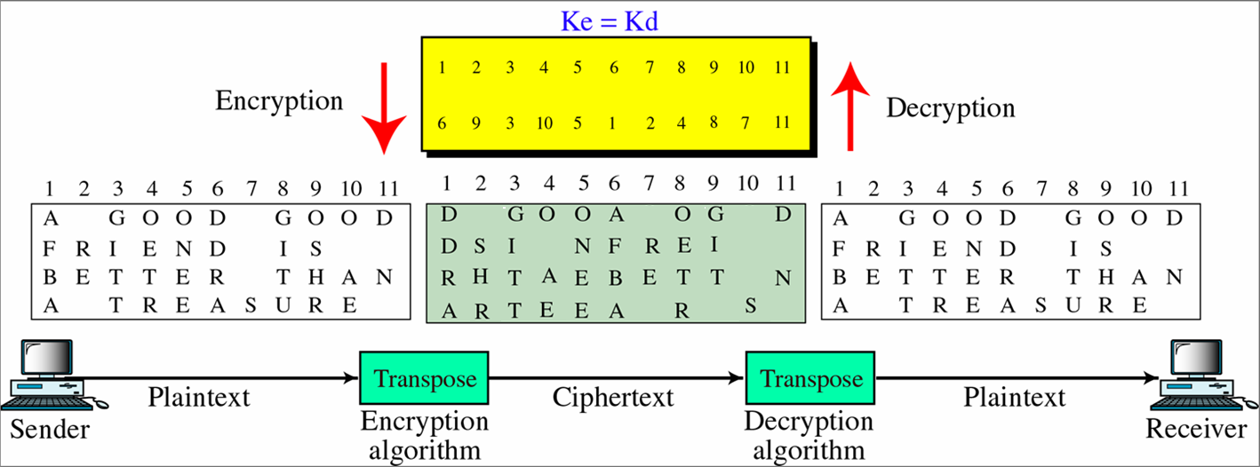
Transposition cipher: Characters retain their value but change their position
Key defines how this re-ordering takes place
Notes:
Error on this page

Slide 51
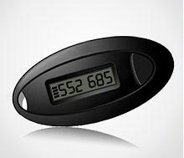
One-Time Pad
If a truly random key is used, the cipher will be secure
An example is a One-Time Pad
The key is used only once!
It is unbreakable since ciphertext bears no statistical relationship to the plaintext
Disadvantage: Problem of safe distribution of key
Lecture 1. Introduction - 51
Notes:
Griffith University, School of ICT
2010/1
51
The One-Time Pad is an evolution of the Vernham cipher, which was invented by Gilbert Vernham in 1918, and used a long tape of random letters to encrypt the message. An Army Signal Corp officer, Joseph Mauborgne, proposed an improvement using a random key that was truly as long as the message, with no repetitions, which thus totally obscures the original message.
Since any plaintext can be mapped to any ciphertext given some key, there is simply no way to determine which plaintext corresponds to a specific instance of ciphertext.

Slide 52
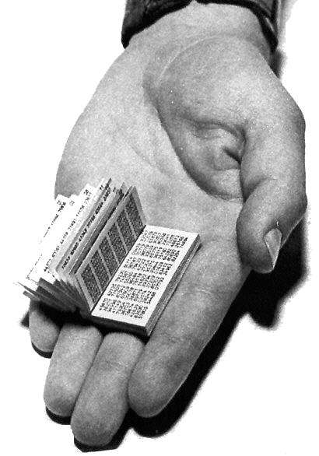
A Russian One-time pad, captured by
MI5 (Military Intelligence, Section 5)
Lecture 1. Introduction - 52

Slide 53
Bit level encryption
Multimedia data (text, graphics, audio, video, digital data etc) are divided into blocks of bits
Then altered by encoding, permutation, substitution, XOR, rotation, etc.

Slide 54
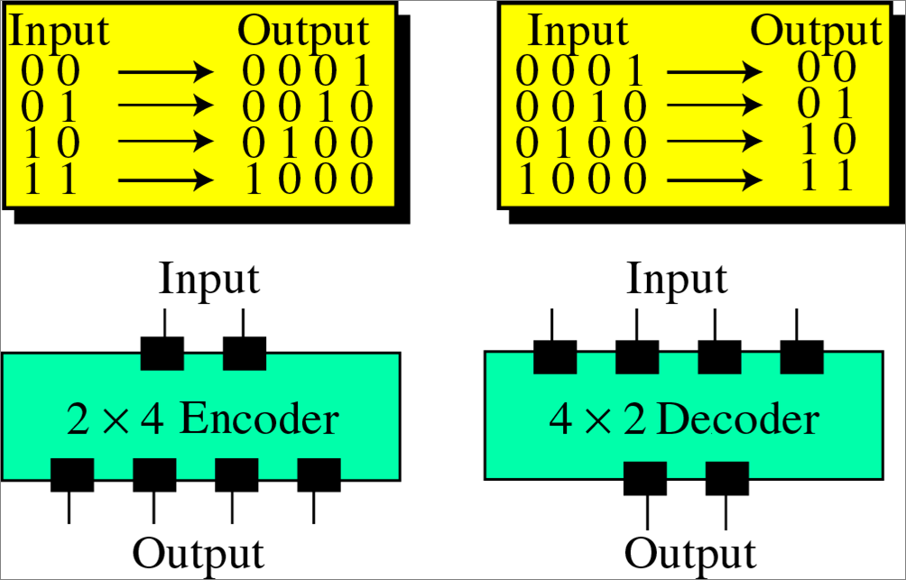
Encoding/Decoding

Slide 55
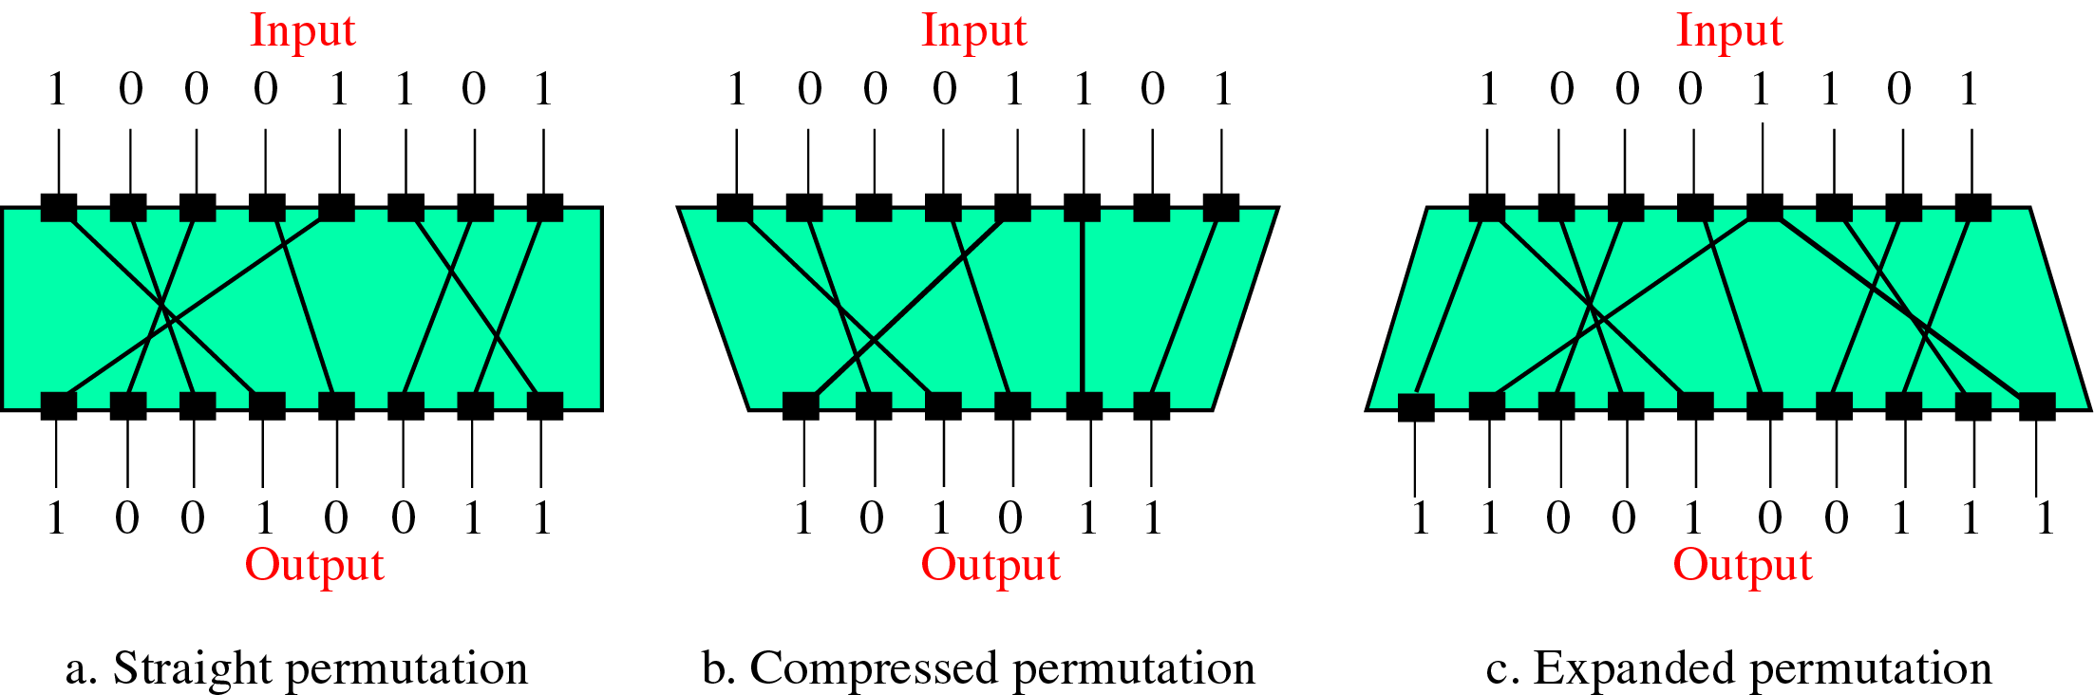
Permutation
Notes:
Midterm exam

Slide 56
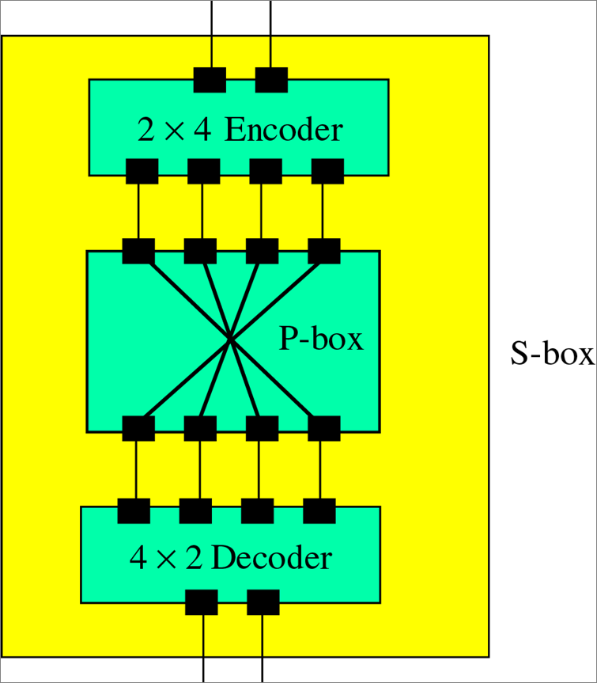
Substitution

Slide 57
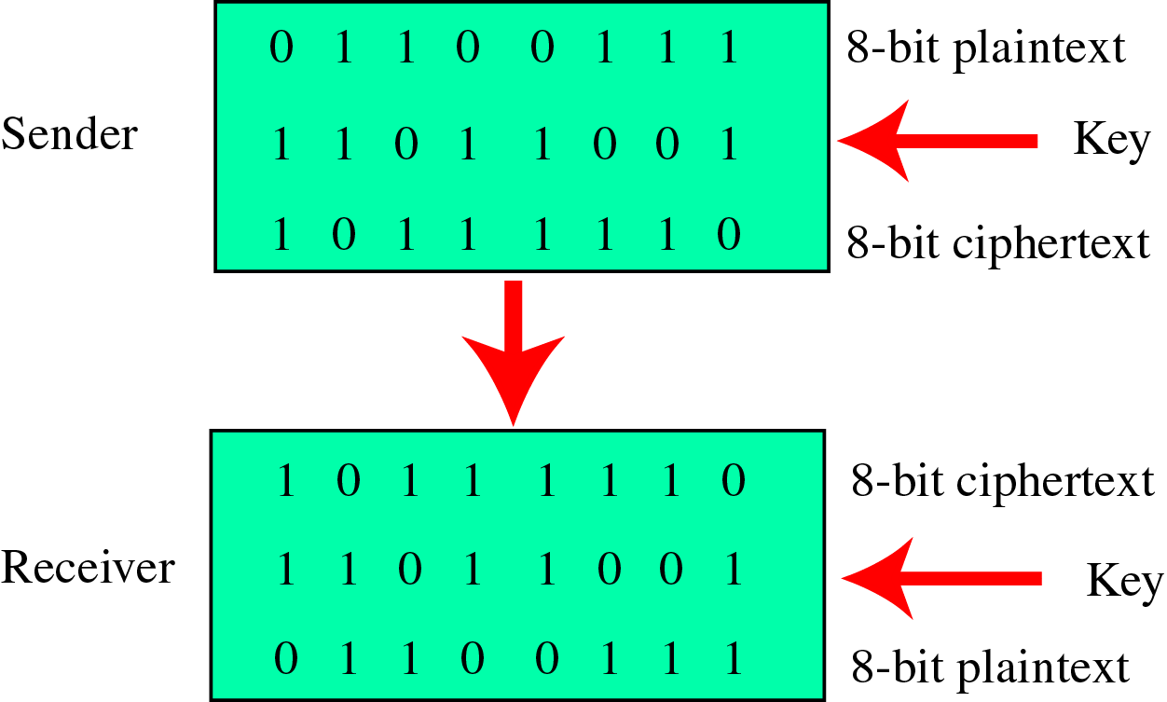
Exclusive OR (XOR)
Notes:
Tutorial question

Slide 58
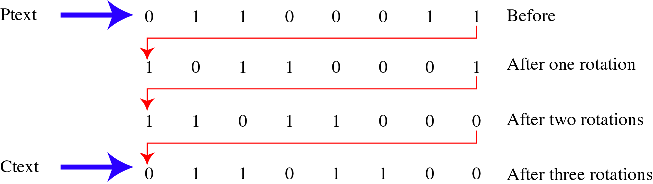
Rotation

Slide 59
Summary
Have considered:
Course details, contents, convenor…
Computer, network, internet security definitions
Security services, mechanisms, attacks
Classical cipher techniques and terminology:
Substitution ciphers
Cryptanalysis using letter frequencies
Poly-alphabetic ciphers
Transposition ciphers

Slide 60

Questions?

